Slide 1
Vaping & Legislation
Brad Barrett, Manny Ramos, Samantha Devlin, Tim Tallent

Slide 2
Hypothesis
(HA) Hypothesis: The adoption of Anti-E-cigarette legislation by states has a direct impact to reducing the percentage of adult E-cigarette users.
(Ho:) Null: The adoption of Anti-E-cigarette legislation by states does not have a direct impact on reducing the percentage of adult E-cigarette users.
Analysis
Planned Analysis : We are going to compare the adult usage rate of the population data to sample data of states with high levels of Anti-E-cigarette legislation to determine statistical significance
Secondary Analysis : If correlation is determined between high legislation states, then we will determine which forms of legislation are more effective.

Slide 3
Source & Behavioral Risk Factor Data
Data Sources:
CDC STATE System E-Cigarette Legislation - Tax U.S. Department of Health & Human Services — 1995-2020
Centers for Disease Control and Prevention (CDC)
State Tobacco Activities Tracking and Evaluation(STATE) System
E-Cigarette Legislation—Tax
Behavioral Risk Factor Data:
Tobacco Use (2011 to present)Survey Data 2011-2018
Centers for Disease Control and Prevention (CDC)
State Tobacco Activities Tracking and Evaluation (STATE) System
BRFSS Survey Data

Slide 4

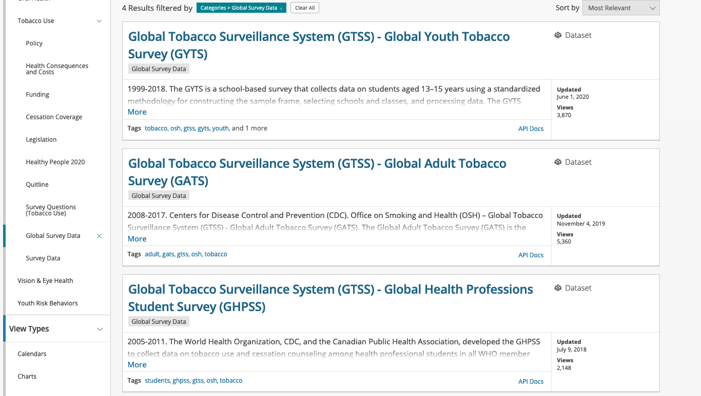

Slide 5
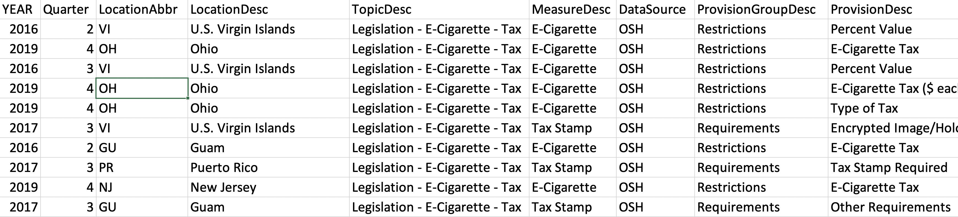
CDC E-Cigarette Legislation by State
State
Type of legislation/regulation
Provisions
Year legislation/regulation were active

Slide 6
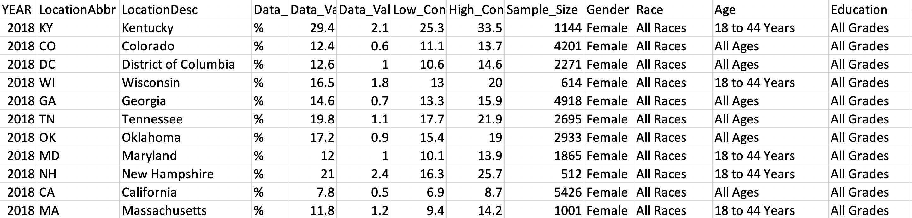
Demographics
State
Age
Race
Method of use

Slide 7
Focused Data
Race
Legislation
% of E-Cig smokers
Tax
Focused by state

